Slide 1

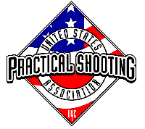
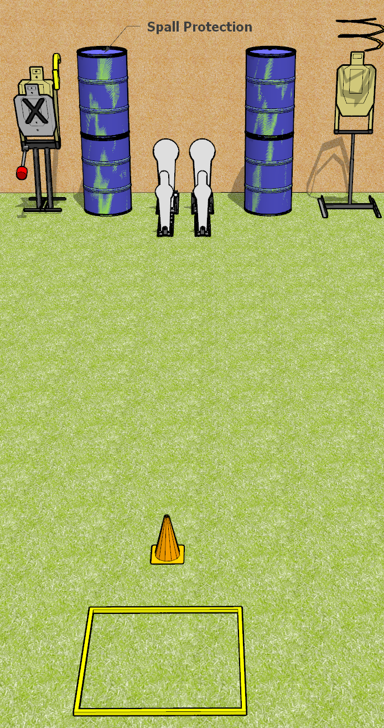
 | Dothan Gun Club – USPSA Match Quick Course Designer : Drew Coleman
START POSITION : Standing in shooting area, wrists below belt
GUN READY CONDITION : Pistol loaded and holstered. PCC loaded, shouldered, safety on, pointed at orange cone. |  | SCORING: Comstock, 8 rounds TARGETS: 2 paper, 4 Steel SCORED HITS: Best 2 on paper, steel until down START-STOP: Audible, last shot RULES: drop turner is a disappearing target
STAGE PROCEDURE: Engage targets as they become available from within the fault lines.

Slide 2
Quick
Written Stage Briefing
Quick is an 8 round, 40 point, Comstock speed shoot. There are two USPSA targets, 2 colt poppers, and two mini poppers. The drop turner is a disappearing target. The best two hits on paper will score, and steel must fall to score. The start signal is audible.
Handgun start position is standing in the shooting box, wrists below belt. Handgun is loaded and holstered.
PCC start position is standing in shooting box, muzzle pointed at cone. Carbine is loaded, held with both hands, safety on.
Upon start signal, engage targets as they become available from within the shooting area. The left Colt popper activates the max trap, and the right Colt popper activates the drop turner.

